Slide 1
Intra-Articular Injection

Slide 2
Intra-Articular Injection
Injection within the joint is used to administer one or more drugs or agents directly into the joint in a sterile conditions .

Slide 3
Joints : Are a junction between two or more bones .
Types of Joints :
There are three types of joints :
1- Fibrous Joint : (Joint of Skull Bones).
2- Cartilaginous Joint : (Vertebrae).
3- Synovial Joint : (Fetlock, Pastern,…..etc.).

Slide 4
Synovial Joint
Is the typical joint and consist of :
Hyaline cartilage of articular surface .
Joint capsule .
Synovial fluid .
Ligaments .

Slide 5
Structure of Synovial Joint

Slide 6
Causes of Intra-Articular Injection (Indication)
The most common reasons for a Vet . Doctor to perform a joint injection are :-
1- To anesthesia or ‘block’ during lameness examination or diagnosis .
2- To injection medications or any agents such as (corticosteroid,PRP,hyaluronic acid, antibiotics….. etc.) .

Slide 7
3-Used to improve flexion.
4-Stop or slow degenerative joint disease.
5-Reduce inflammation and swelling in joint.
6-Primarily used in competitive animals(racing).

Slide 8
Where Can You Inject?
Hock.
Stifle.
Coffin Bone.
Ankle (Pastern/Fetlock).
Knee.
Sacroiliac joint (Lower back above pelvis).

Slide 9
Joints of hind limb :
Sacroiliac joint.
Hip joint .
Stifle joint .
Hock joint .
Fetlock joint .
Pastern joint .
Coffin joint .

Slide 10
Joint of fore limb :
Shoulder joint .
Elbow joint .
Knee joint .
Fetlock joint .
Pastern joint .
Coffin joint .

Slide 11
Type of injected materials
1. Anti inflammatory drugs (such as corticosteroids).
2. Hyaluronic Acid .
2. Platelet Rich Plasma (PRP).
4. Local anesthesia ( lidocaine ,…etc.).

Slide 13
Technique of Intra-Articular Injection
Preparation to Injection :
Clean the joint firstly with an antiseptic to reduce contaminations at the site of injection .
Clipping and shaving .
Cleaning of skin with soap .
A Septic preparation of skin .
Sterile technique ( gloves, needle, syringe ).

Slide 15
Complications of Intra-Articular Injection
Joint infection.
Cellulitis.
Skin ulcerations.
Osteomyelitis.
Infectious arthritis.
Epidural abscess.

Slide 31
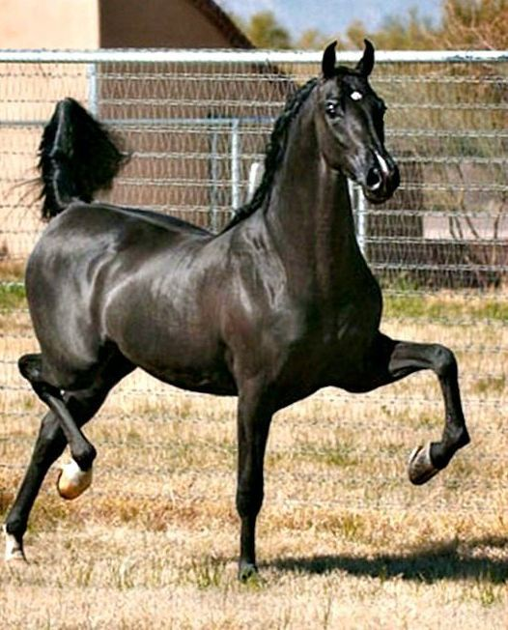
قال رسول الله صلى الله عليه وسلم: “خَيْرُ الْخَيْلِ الْأَدْهَمُ، الْأَقْرَحُ، الْأَرْثَمُ، المُحَجَّلُ ثَّلَاثِ، مُطْلَقُ الْيَمِينِ، فَإِنْ لَمْ يَكُنْ أَدْهَمَ، فَكُمَيْتٌ عَلَى هَذِهِ الشِّيَةِ”

